Slide 1

Heart Stroke Prediction
Ayesha Shariff (21BDA18)
Aaron D'lima (21BDA23)
Shivanshi Maheshwari (21BDA33)

Slide 3
About the Dataset
The variables that we have are:
gender, age, hypertension, heart_disease, ever_married, work_type, Residence_type, avg_glucose_level, bmi, smoking_status, stroke
We got the dataset from Kaggle.
We are trying to predict the people who are more prone to getting a stroke, based on these variables.

Slide 4
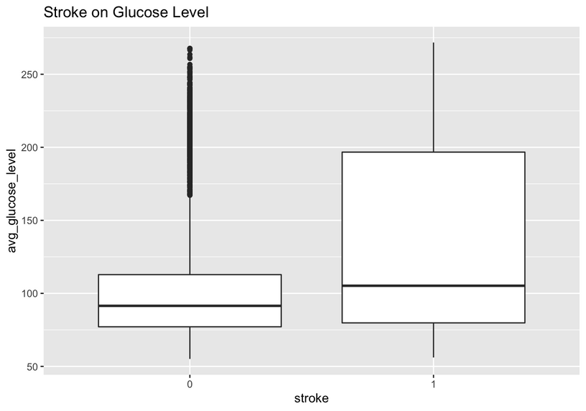
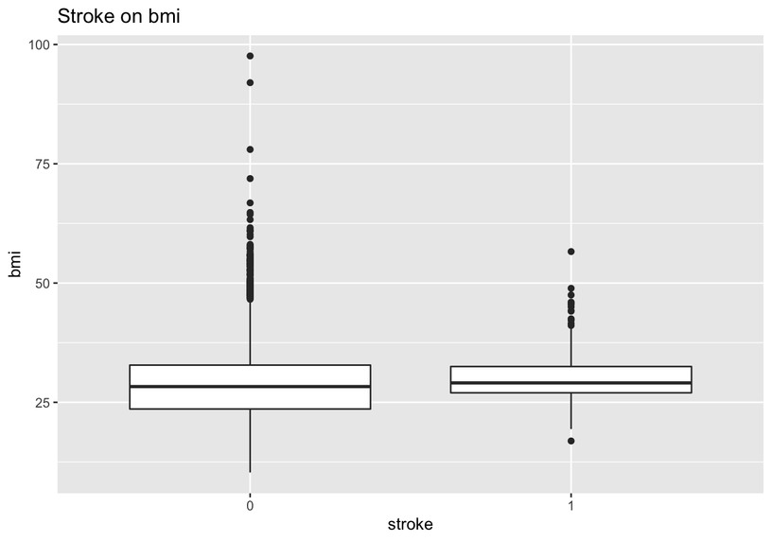
Conclusions from the EDA
We can conclude from these plots that those who have stroke have a higher glucose level and bmi, but it’s not that significant because of the outliers.

Slide 5
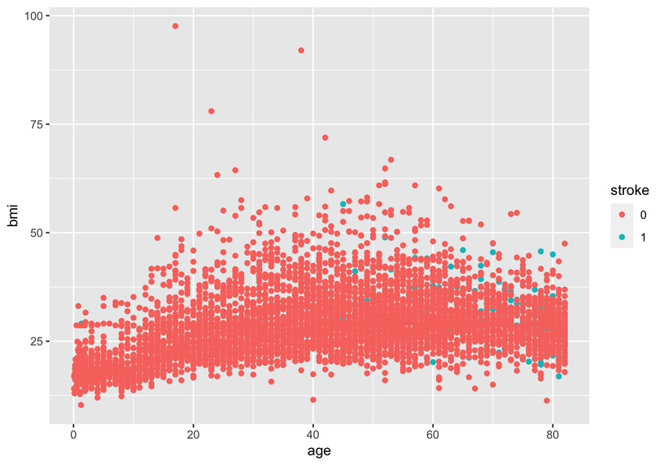
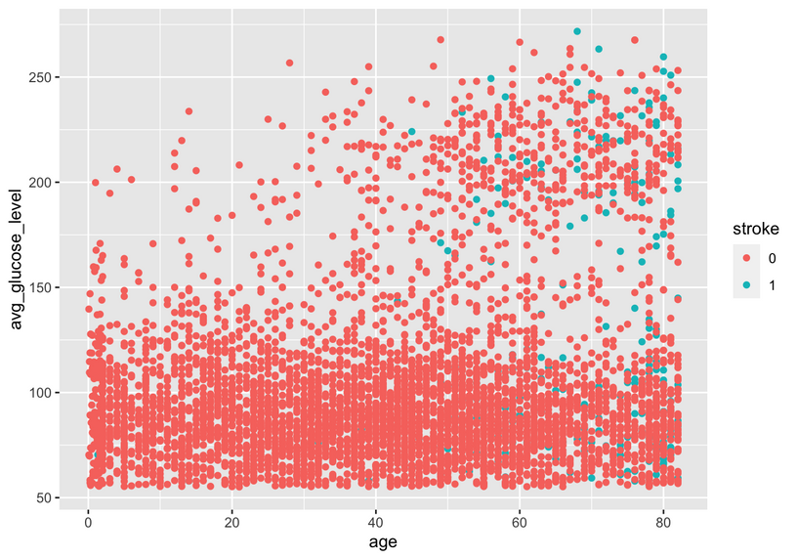
Conclusions from the EDA
We can conclude from these plots that stroke patients are more likely to appear at older age and people with high bmi and average glucose levels.

Slide 6
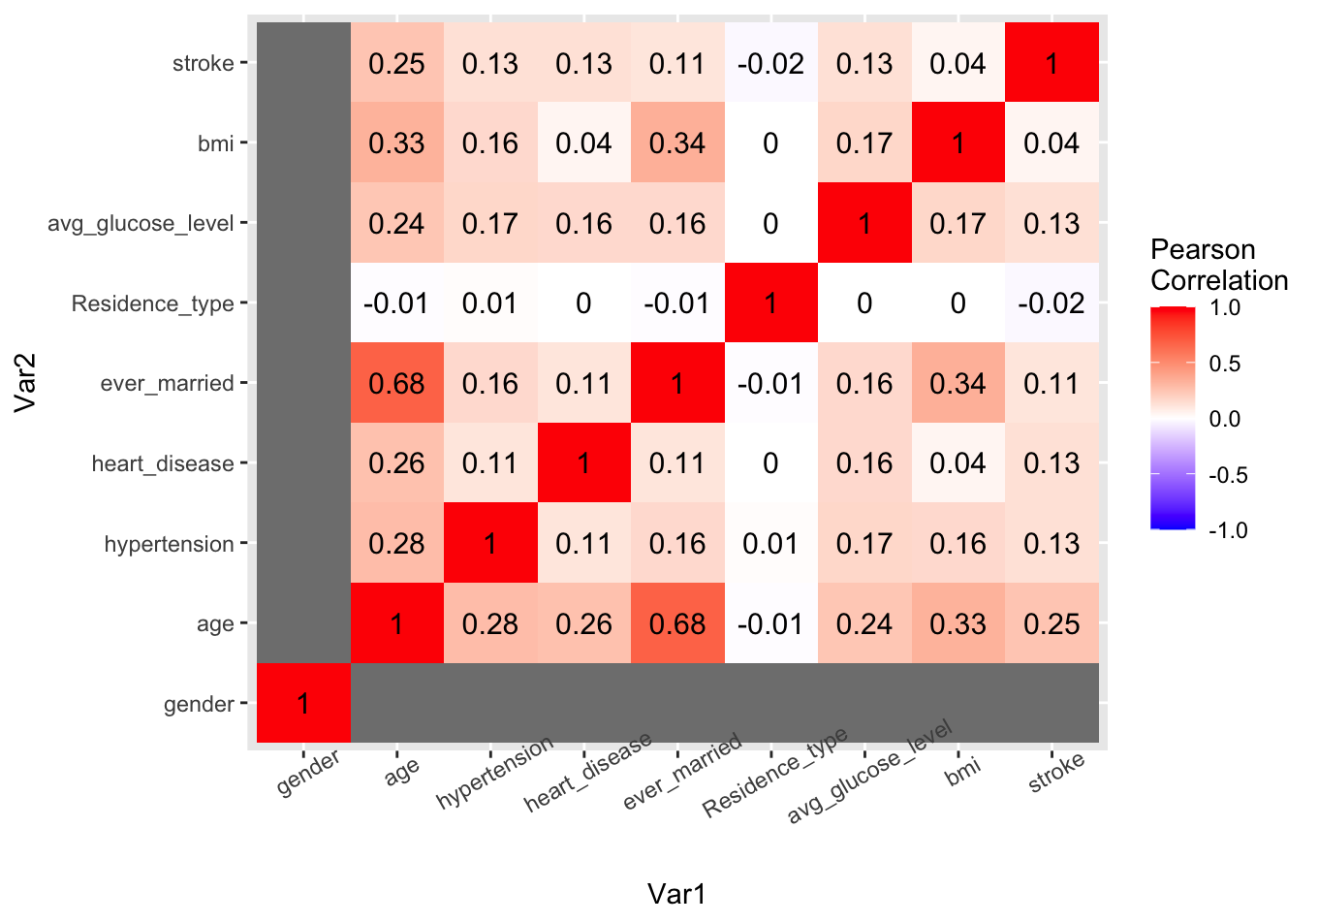

As we can see from the heatmap, most features don’t have a significant correlation with others, which is suitable for regression. The only worth-noticing correlation is between age and ever_married. Among all features, age has the largest correlation coefficients with stroke.

Slide 7
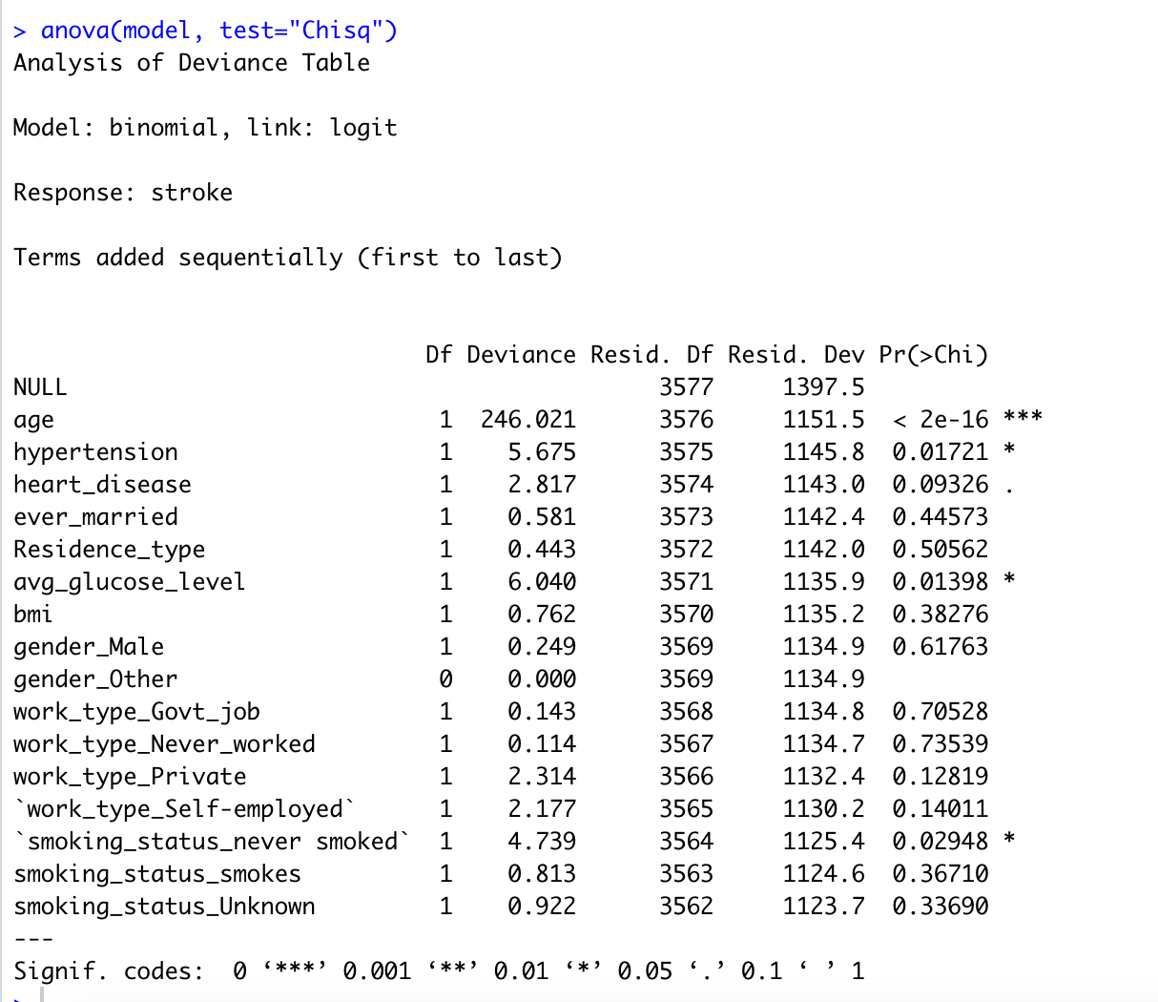
Besides Gender, work_type and smoking_status, in the regression result, avg_glucose_level also significantly lowers the deviance. Those features with a large p-value shows that even without these features, the model would explain more or less of the same of total variation.

Slide 8
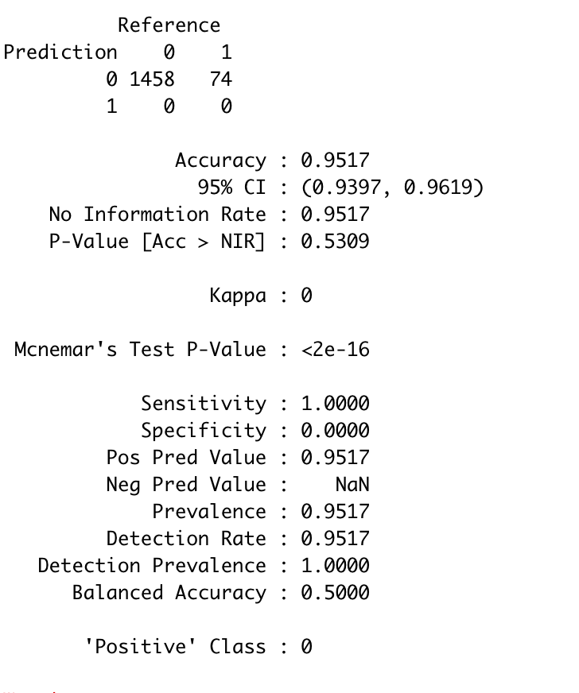
From the confusion matrix report, we could find the accuracy to be 0.95, which is relatively high.
The outcome ‘stroke’ is so imbalanced that the model believes that almost all the outcomes are 0. It’s hard to distinguish the one with the stroke and the one without it.

Slide 9
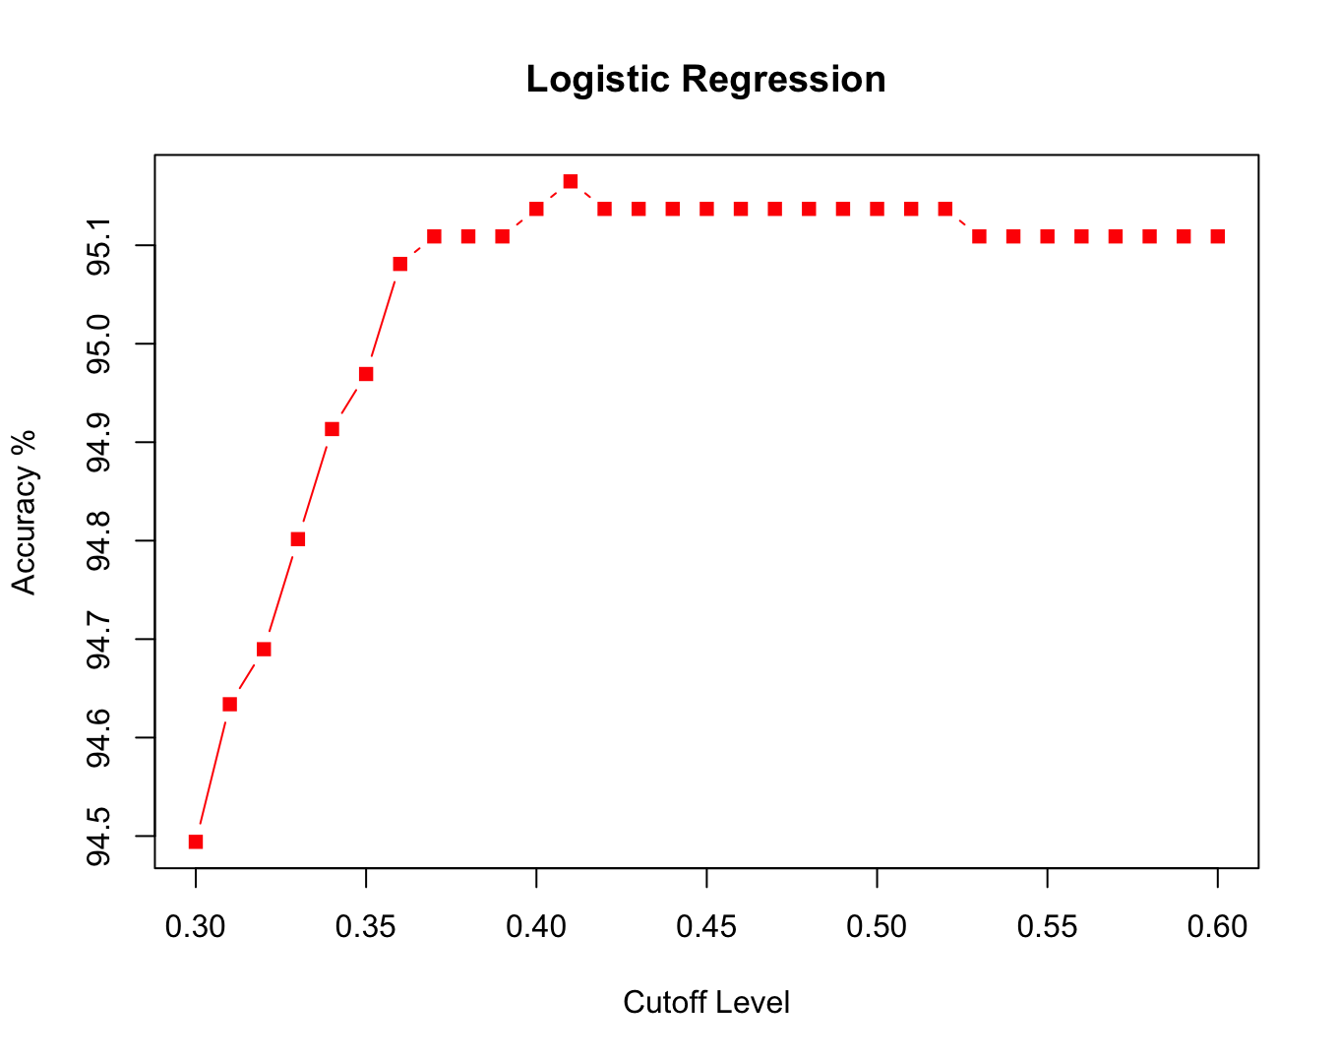
The results from the logistic Regression are also not very pleasing because of the imbalance in the dataset.

Slide 10
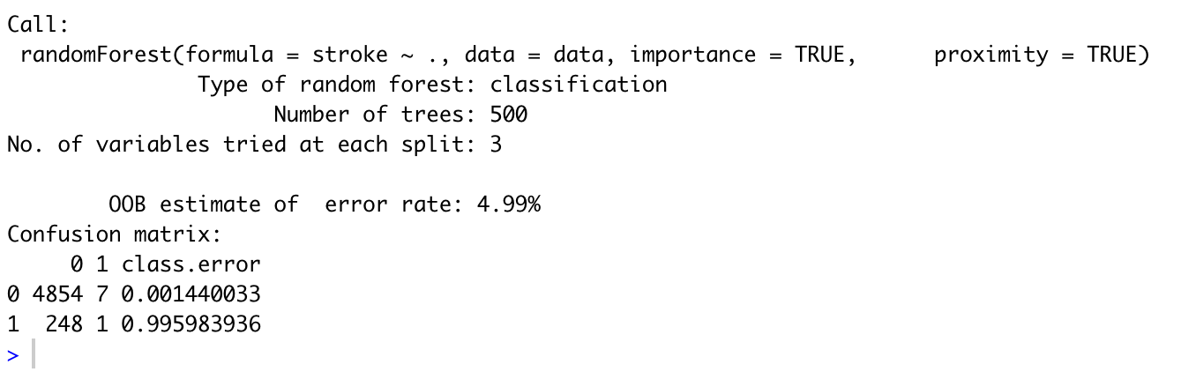
The results from the Random Forest classifier also show 95% accuracy.

Slide 11
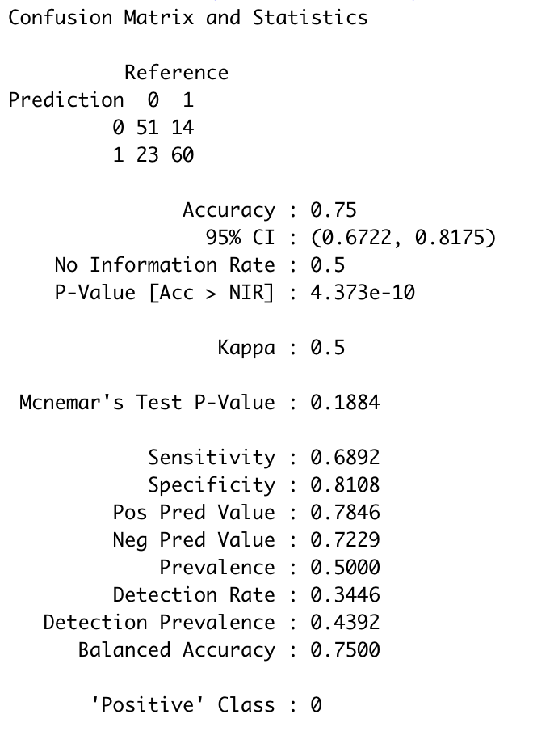
Since the data was imbalanced, we used the under fitting method to deal with it.
The result from the confusion matrixof logistic regression shows, 75% accuracy.

Slide 12
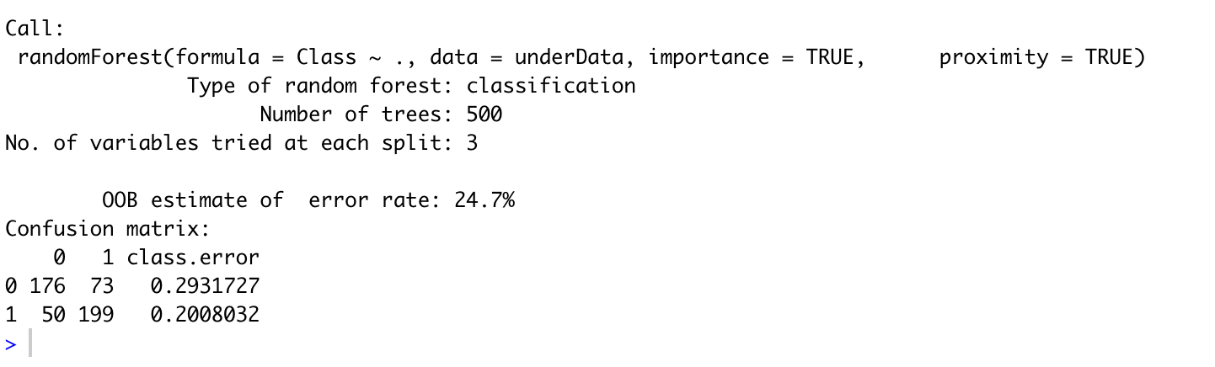
The Random forest classifier gives 75.3% accuracy.

Slide 13
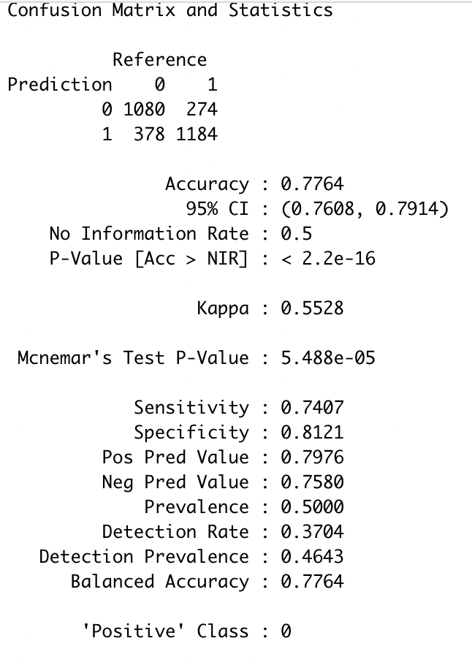
Since the data was imbalanced, we used the over fitting method to deal with it.
The result from the confusion matrix of logistic regression shows, 77% accuracy.

Slide 14
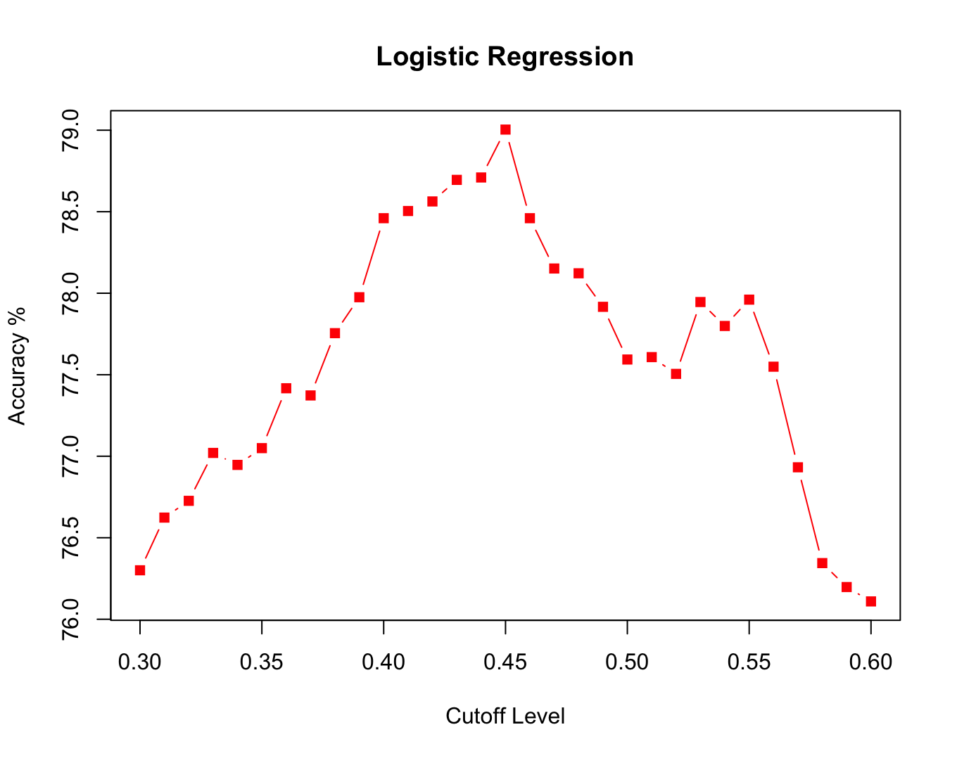
The results from the logistic Regression are also show 77-79% accuracy in the dataset.

Slide 15
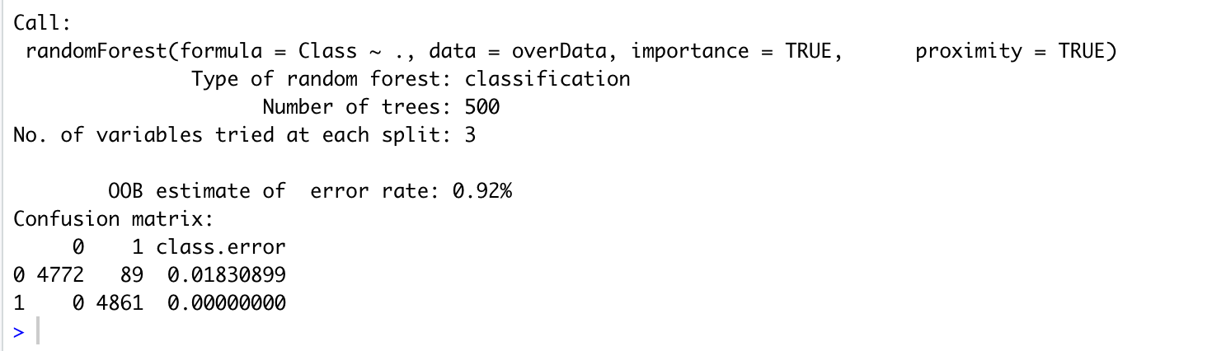
The Random forest classifier gives 99.08% accuracy.

Slide 16
Conclusion
In this project, we used logistic regression to discover the relationship between stroke and other input features.
We get the conclusion that age, hypertension and work_type_self-employed would affect the possibility of getting stroke.
We also use logistic regression and random forest to build a prediction model for stroke. Both model reach the accuracy of 95%, but the imbalance of dataset has limited the accuracy level.
Using the underfitting method, we saw that the accuracy reduced to 75%.
Using the overfitting method, we saw that the accuracy increase to 99.08% using Random Forest Classifier.

Slide 17
Next Course of Action
We will be using SMOTE method also to deal with the imbalanced data.
After that we will again use the same models to check whether they are good or not.
We will try to implement other models to obtain better accuracy

Slide 18
Thankyou!

